Slide 1
TRUST AND CORPORATE SERVICES PROVIDERS
STREAMLINING COMPLIANCE: INTRODUCING THE REPORTING FORMS
Presenter: Phillip Chin-See

Slide 2
Supervisory Framework
Legislative Framework and Regulatory Requirements
Reporting and Disclosure
Reporting Forms – (Overview)
Compliance Report
Annual Information Return
Audited Financial Statements
Completing the Form 12
Q&A
Outline

Slide 3
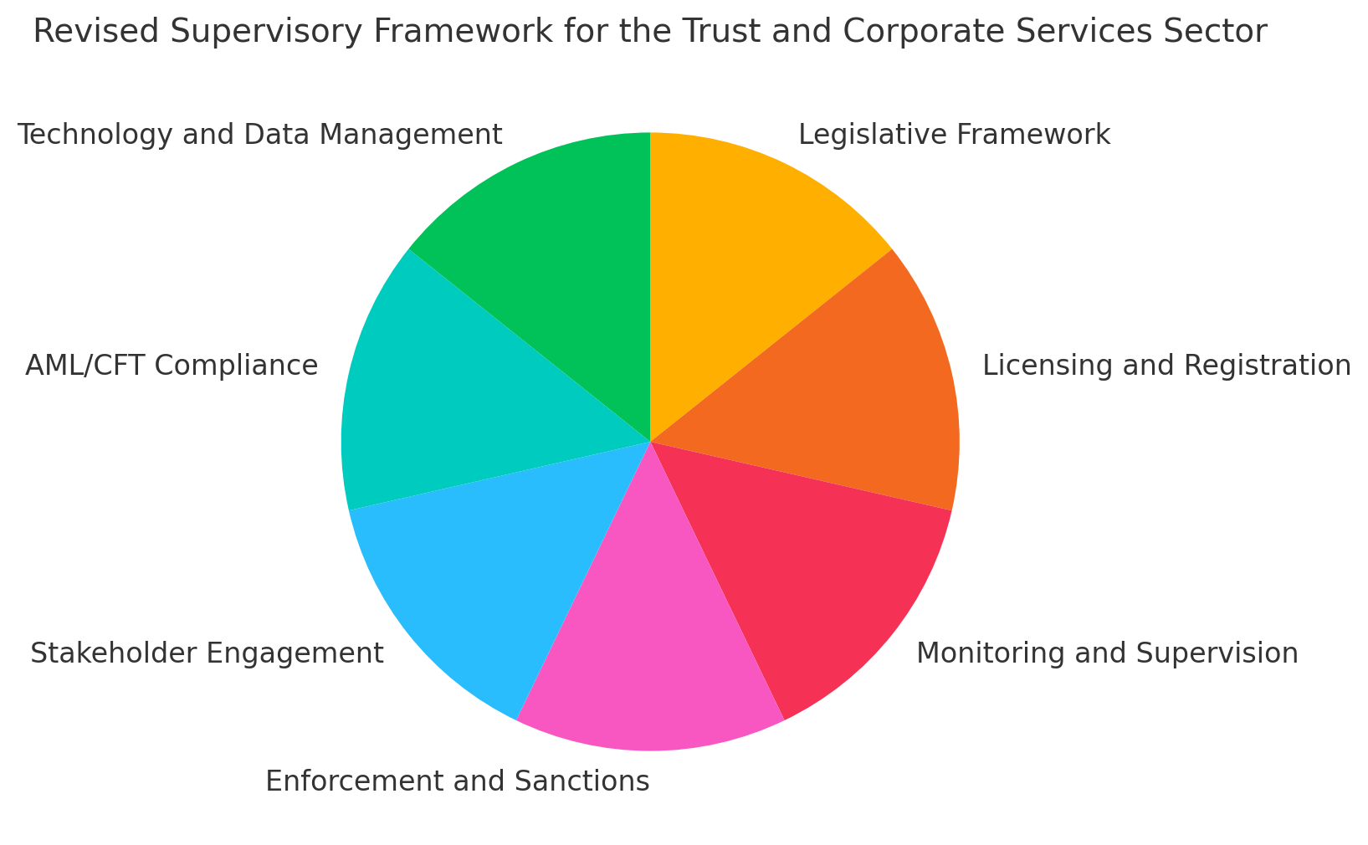
Supervisory Framework for the Trust and Corporate Services Sector

Slide 4
The Legislative Framework
The Trust and Corporate Services Providers Act, 2017
(the “TCSP Act”)
Section 4(1)(d) : “monitor and examine the businesses of service providers in such manner as it thinks necessary to determine whether service providers are in compliance with this Act and any regulations made under this Act and are in good financial standing”
The Trust and Corporate Services Providers (Licensing and
Operations) Regulations, 2022 (the “TCSP Regulations”)
Regulation 11: “A licensee shall provide such documents and information (whether in a physical or electronic form) in relation to any customer or service provided by the licensee, within the timelines specified by the Commission”
Regulation 14: “A licensee shall file with the Commission, in the form, manner and frequency determined by the Commission, reports or any record required to be kept pursuant to the Act or these Regulations”

Slide 5
Reporting & Disclosure
Importance of Reporting and Disclosure:
These are fundamental components for maintaining transparency and accountability in the financial sector.
The FSC conducts its monitoring activities through a combination of off-site and on-site examinations using a risk-based approach to supervision of the TCSP sector.
Statutory and other reports are used by the FSC to conduct ongoing assessments of service providers, through the identification and monitoring of risks within the TCSP sector.
2. Compliance with Regulatory Requirements:
Ensure reports meet all regulatory standards that are set. This includes submission of financial statements, client information, and any specific disclosures required under Anti-Money Laundering (AML) and Counter Financing of Terrorism (CFT) legislation.

Slide 6
Reporting & Disclosure
3. Accuracy and Timeliness:
The accuracy of your disclosures cannot be overstated. Inaccurate or
incomplete reports can lead to regulatory scrutiny or fines. On the contrary,
accurate and timely submission of reports is essential to maintaining your good
standing with the FSC.
Your commitment to accurate and timely reporting is crucial for upholding the
integrity of the financial system.
4. Consequences of Non-Compliance:
These can range from fines and penalties to reputational damage and revocation or suspension of licence to conduct business. It is important to maintain compliance, as part of your broader risk management strategy.

Slide 7
Reporting & Disclosure
5. Technology and Data Management:
Leverage technology to streamline your reporting processes. Ensure that your data management systems are robust, secure, and capable of producing the required reports efficiently. This will not only help in compliance but also in responding quickly to any regulatory inquiries or changes.
6. Stakeholder Engagement:
Transparency in reporting fosters trust with your stakeholders, including clients, regulators, and the broader public. By maintaining clear and honest disclosure practices, you enhance your reputation and contribute to the overall stability and trust in the financial services sector.
7. Continuous Improvement:
Reporting and disclosure are not just compliance exercises; they are opportunities to review and improve your operations. Regularly assess your processes to identify areas for improvement, ensuring that your practices evolve with changing regulations and industry standards.

Slide 8
Reporting & Disclosure
8. Audit Readiness:
Ensure that your organization is audit-ready at all times. Regular internal audits and reviews of your reporting processes can help identify any gaps or areas for improvement, reducing the risk of non-compliance during an external audit.
9. Ethical Consideration:
Beyond legal obligations, there is the ethical responsibility to report honestly and transparently. Ethical practices will build trust with clients and the FSC, positioning your entity as a reliable and responsible service provider in the industry.

Slide 9
Bulletins and Guidelines issued by the FSC
Information Bulletin For Service Providers: Submissions to the Financial Services Commission by Service Providers – RCTS-ADVI-22/07-0007
Outlines the reporting requirements of licensees
In keeping with Regulation 14 of the TCSP Regulations, the following reports are to be filed by licensees:
Compliance Report – Form CRF/TCSP (Form12)
Deadline three months after the calendar year
Annual Information Return – Form AIR/TCSP (Form 13)
Deadline three months after the calendar year
Audited Financial Statements – Form 14
Deadline three months after the financial year-end of the licensee

Slide 10
Reporting Forms
Licensees are encouraged to familiarize themselves with the forms, especially for those persons who had not previously commented on same. Additionally, this is an opportunity for all users to provide comments on possible improvements or inform the FSC of any challenges faced while completing the forms.
The forms are posted on the FSC website and contain explanations and instructions for completing same
Complete and accurate information must be reported - providing false or misleading information is an offence under section 26 of the TCSP Act.
Submissions are to be made by registered mail through the post or hand delivery to the offices of the Financial Services Commission at 39-43 Barbados Avenue, Kingston 5; and to both of the following email addresses:
records@fscjamaica.org
Rcts@fscjamaica.org

Slide 11
Reporting Forms
Submission may also be made via a portal on the website, however, this option is not yet available
Drop down boxes are included to make completion of the form less time consuming
Date format (dd/mm/yyyy) is to be observed throughout
Data entry in some parts of the forms are prohibited
There is also a Guide to Completing Form 13 and Form 14 on the website to
assist when completing the forms. The Guide contains, among other things:
General instructions on completion and submission of reports
Glossary and Definitions of terms
The FSC will communicate with the licensee regarding any issues/concerns emanating from the review of the reports
The FSC will be sending out a Major Business Activity Form – Form 18 within the first week of September seeking information on the significant business activities undertaken for each service.

Slide 12
Compliance Report – Form 12
Section 17A(4)(b) of the TCSP Act require submission of compliance reports by the Principal Representative
The report solicits information on whether you have conducted your TCSP business in conformity with the legislation, good governance and best practices
Submission is to be made within three months after the end of each calendar year
Must be signed by the head of the compliance function and the Principal Representative
Among other things, it captures information regarding:
compliance function
outsourcing arrangements
records management and maintenance of registers
AML/CFT programme

Slide 13
Completing the Form 12
Compliance
Report
“Form 12”

Slide 14
QUESTIONS
IF YOU HAVE ANY QUESTIONS, FEEL FREE TO ASK THEM NOW!

Slide 15
THANK YOU!
39-43 Barbados Avenue
(876) 906-3010-2
www.fscjamaica.org
RCTS@fscjamaica.org
WE'D LOVE TO HEAR ABOUT YOUR EXPERIENCE AT TODAY'S WEBINAR! FILL OUT THE QUICK AND EASY SURVEY TO LET US KNOW!

